Slide 1

Technology
Version 1.0
Venkata Kishore Vedam

Slide 2
Topics
Introduction
Architecture Overview
Presentation Layer (ReactJS)
API Layer (Node.js)
Application Layer (Python Flask)
Data Layer (MySQL)
SaaS Model Customization
Deployment & Implementation

Slide 3
Introduction
This documentation describes a 4-tier architecture application developed using the following technologies:
ReactJS for the Presentation Layer (UI/UX)
Node.js for the API Layer (API requests & authentication)
Python Flask for the Application Layer (business logic and computations)
MySQL for the Data Layer (persistent data storage)
The system is designed to be implemented for clients or offered as a Software as a Service (SaaS) model. The application can be customized based on client requirements and specific business needs.

Slide 4
Architecture Overview
The 4-tier architecture is designed to separate concerns, improve maintainability, and enhance scalability. Each layer handles specific tasks, and communication between layers is done using standard protocols such as HTTP or REST APIs.
The Four Layers:
Presentation Layer (ReactJS)
API Layer (Node.js)
Application Layer (Python Flask)
Data Layer (MySQL)

Slide 5
Presentation Layer (ReactJS)
Presentation Layer (ReactJS)
Technology: ReactJS
Purpose: The Presentation Layer is responsible for the User Interface (UI) and User Experience (UX). This layer interacts directly with the user.
Responsibilities:
Render the UI components.
Display data received from the API layer.
Send user input (such as form submissions) to the API layer.
Handle client-side routing.
Communication:
The ReactJS frontend communicates with the API Layer (Node.js) using HTTP requests (REST APIs).
Example:
The user interacts with a web page where they can view a dashboard, fill out forms, and interact with data.
ReactJS fetches data from the API (Node.js) and displays it to the user in an interactive way (e.g., charts, tables, forms).

Slide 6
API Layer (Node.js)
Technology: Node.js
Purpose: The API Layer is responsible for handling API requests and managing user authentication.
Responsibilities:
Handle incoming API requests from the front-end (ReactJS).
Perform user authentication and authorization.
Interface with the Application Layer (Python Flask) to process complex business logic.
Return processed data back to the frontend (ReactJS).
Communication:
The Node.js server exposes REST APIs to the front-end and makes internal requests to the Application Layer (Python Flask).
Example:
A ReactJS frontend sends an HTTP request (e.g., GET /api/user) to the Node.js server.
The Node.js server authenticates the user and forwards the request to the Application Layer for processing.
The data is returned to the frontend for rendering.

Slide 7
Application Layer (Python Flask)
Technology: Python Flask
Purpose: The Application Layer is responsible for the core business logic, computations, and data processing.
Responsibilities:
Implement application-specific logic such as user management, data transformations, and business rules.
Perform heavy computations or data manipulation before sending the result back to the API Layer (Node.js).
Communication:
The Application Layer receives requests from the API Layer (Node.js) and processes them.
After processing, the results are sent back to the API Layer for further action.
Example:
When the API Layer requests to calculate some business metric, the Python Flask layer performs the necessary computations and returns the result.
Flask can also handle any data transformations or complex computations that are required by the business.

Slide 8
Data Layer (MySQL)
Technology: MySQL
Purpose: The Data Layer is responsible for persistent data storage.
Responsibilities:
Store and manage the application's data (e.g., users, transactions, logs, etc.).
Provide an interface for the Application Layer to query and manipulate data.
Communication:
The Application Layer (Python Flask) communicates with the Data Layer (MySQL) to perform CRUD operations (Create, Read, Update, Delete).
The API Layer (Node.js) can also interact with the MySQL database via the Application Layer if necessary.
Example:
The Python Flask layer queries the MySQL database to retrieve or store data.
The API Layer may make requests to retrieve user data, which is then fetched from MySQL.

Slide 9
SaaS Model Customization
This application can be deployed as a Software as a Service (SaaS), making it available to multiple clients in a multi-tenant architecture. The SaaS model provides:
Scalability: Easily scale to handle multiple clients simultaneously.
Customization: Each client can have a customized version of the application, including unique branding, specific workflows, and tailored features.
Centralized Maintenance: Updates and bug fixes are centrally deployed, ensuring all clients have access to the latest version.
Clients can customize:
Themes and branding in the presentation layer.
Business logic within the application layer (Python Flask).
API endpoints and data schemas to meet specific needs.

Slide 10
Deployment & Implementation
The application can be deployed either on-premises for clients or as a SaaS offering in the cloud. The components can be deployed using technologies such as Docker for containerization and Kubernetes for orchestration.
Deployment Steps:
Frontend (ReactJS):
Build the ReactJS application.
Deploy it using a static file server or a cloud service like AWS S3 or Netlify.
Backend (Node.js + Flask):
Set up Node.js and Flask applications as services on a server.
Use Docker containers for both Node.js and Python Flask to ensure portability and scalability.
Database (MySQL):
Deploy MySQL on a cloud-based database service like AWS RDS or manage it on your own servers.
Ensure proper security measures for database access (e.g., encryption, access control).
API Layer:
Expose REST APIs to the ReactJS frontend and integrate authentication/authorization mechanisms (e.g., JWT).

Slide 11
Web Client Components
The structure of the application is as below , This structure consist both configurations and the m
Frontend (ReactJS):
Build the ReactJS application.
Deploy it using a static file server or a cloud service like AWS S3 or Netlify.
Backend (Node.js + Flask):
Set up Node.js and Flask applications as services on a server.
Use Docker containers for both Node.js and Python Flask to ensure portability and scalability.
Database (MySQL):
Deploy MySQL on a cloud-based database service like AWS RDS or manage it on your own servers.
Ensure proper security measures for database access (e.g., encryption, access control).
API Layer:
Expose REST APIs to the ReactJS frontend and integrate authentication/authorization mechanisms (e.g., JWT).

Slide 12
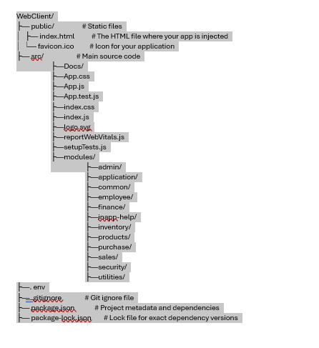
Web Client Components
The structure of the Front-end application is as below , This structure consist both configurations various modules as below
Admin: Manages administrative tasks, including configuration settings and system setup.
Application: The main menu of the application, providing access to all available modules.
Common: Allows the creation of enterprise-level setups, such as companies and tax codes.
Employee: Facilitates employee management and creation.
Finance: Handles the creation of invoices for both purchases and sales.
Inventory: Manages inventory-related tasks and stock control.
Purchase: Covers procurement processes and related functionalities.
Sales: Manages the sales module and its associated features.
Security: Responsible for user access management and security settings.
Utility: Provides application utilities, including log files and other system tools.

Slide 13
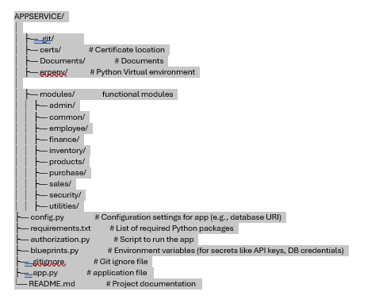
App Service
The structure of the Python Flask App Service application is as below , This structure consist both configurations various modules as below
Admin: Provides REST API endpoints to manage administrative tasks, including configuration settings and system setup.
Application: Exposes REST API endpoints that serve as the main menu, providing access to all available modules in the application.
Common: Offers REST API endpoints for creating enterprise-level setups, such as companies, tax codes, and other essential configurations.
Employee: Provides REST API endpoints to manage and create employee records, as well as handle employee-related actions.
Finance: Exposes REST API endpoints to create and manage invoices for both purchases and sales transactions.
Inventory: Provides REST API endpoints to handle inventory-related tasks, including stock control and product management.
Purchase: Offers REST API endpoints to manage procurement processes, including vendor interactions and purchase order creation.
Sales: Exposes REST API endpoints to handle sales activities, including processing orders and managing customer transactions.
Security: Provides REST API endpoints for managing user access, authentication, and security settings.
Utility: Offers REST API endpoints for application utilities, such as handling log files, system tools, and other administrative tasks.

Slide 14
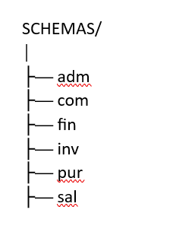
Databases
The structure of the database is as below , each data base is mapped to a module and its related tables.
adm Schema: Contains tables for managing enterprise-level setups such as config tables.
com Schema: Contains tables for managing enterprise-level setups such as companies, tax codes, and locations.
fin Schema: Contains tables for handling financial operations like invoices, payments, and account management.
inv Schema: Contains tables for managing inventory data, including product details, stock levels, and categories.
pur Schema: Contains tables for storing procurement-related data such as purchase orders, vendors, and order items.
sal Schema: Contains tables for managing sales transactions, including customer orders, payments, and order items.

Slide 15
Questions

